Slide 1

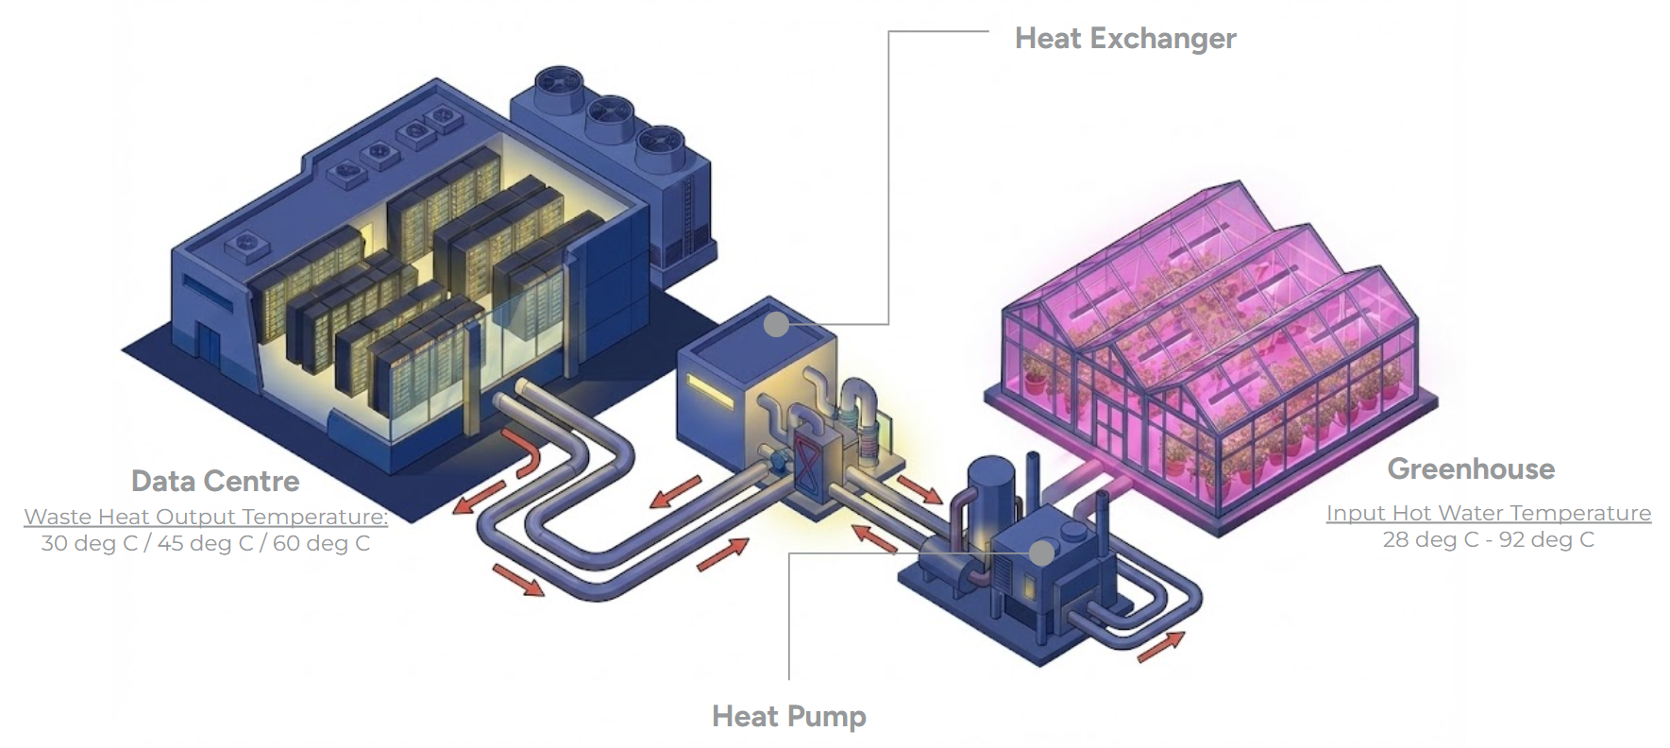
Data Centre & Greenhouse
Waste Heat Utilization
Summary Report:
Prepared for Microsoft by Orbital Farm
December 2025
Scot Bryson
scot.bryson@orbital.farm
CONFIDENTIAL

Slide 2
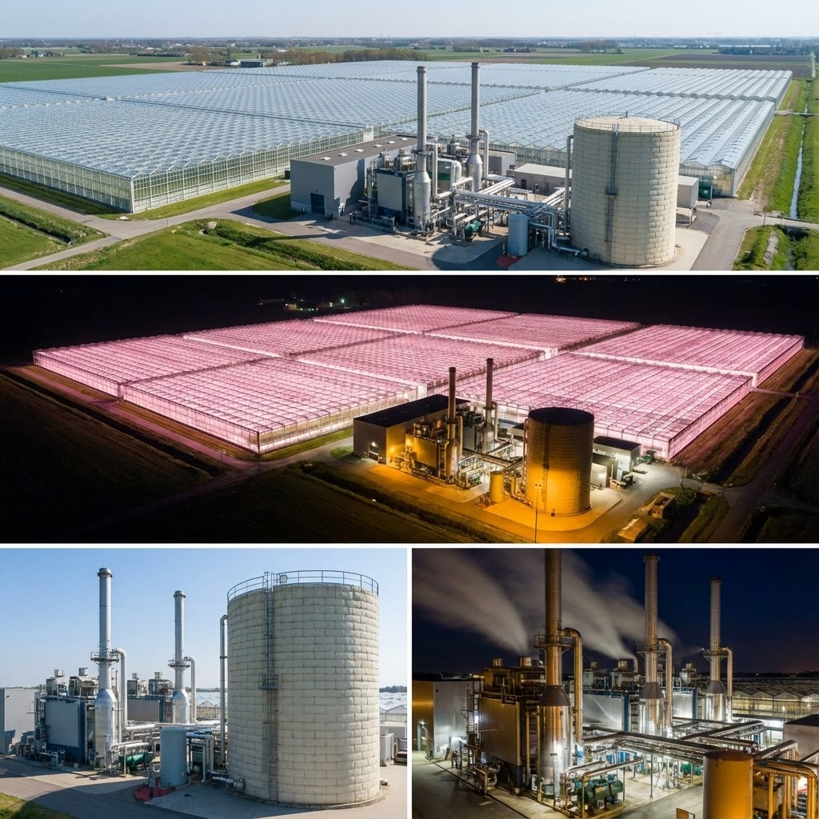
Commercial
Greenhouse
Technology | Climate Control Level | Estimated Investment (€/m²)
Low-Tech | Passive/Limited | < 30
Mid-Tech | Semiactive | 30 to 60
High-Tech | Active/Fully Controlled | > 60 (up to 500)
Vertical Farm | Fully Control + Cooling | > 1000 to 1800 (up to 2000)
In General, high tech greenhouses produce 250 to 600 tonnes of tomatoes per hectare (Source).

Slide 3
Typical growing temperatures greenhouse crops
Crops | Day Time Temperature (°C) | Night Time Temperature(°C)
Peppers | 20 - 30 | 16 - 30
Tomatoes | 21 - 25 | 17 - 20
Cucumber | 25 - 28 | 21
Lettuce | 25 | 20
Poinsettias | 21 - 27 | 19 - 22
Carnations | 25 | 10
Geraniums | 21 - 27 | 18
Notes:
https://drygair.com/blog/what-are-the-ideal-conditions-for-greenhouse-tomatoes/

Slide 4
Design Basis Comparison Table
Between Ontario Canada and Netherlands
Parameter | Middenmeer, NL | Leamington, ON | Implication for 10 MW Design
Design Temp (T_{out}) | -10°C | -23°C | Leamington requires ~45% more peak capacity per m²
Design Temp (T_{in}) | 18°C | 18°C | Standard tomato night setpoint.
Delta T (ΔT) | 28°C | 41°C | Driving force for conduction losses.
Wind Velocity Design | 8 m/s | 10 m/s | Higher infiltration risk in Leamington.
Snow Melt Load | Negligible | Critical | Leamington requires dedicated gutter heat capacity.
Notes:
https://drygair.com/blog/what-are-the-ideal-conditions-for-greenhouse-tomatoes/

Slide 5
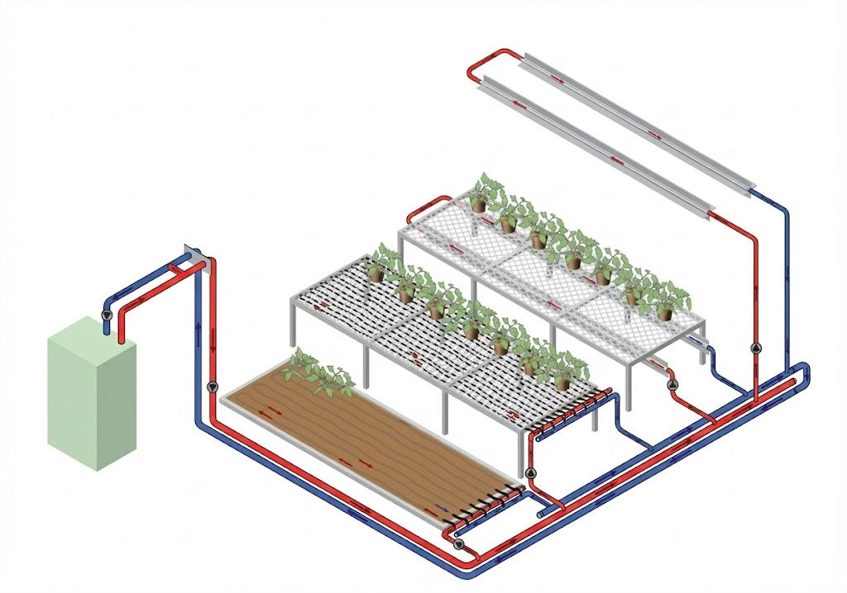
Heat Supply to Greenhouse
Hot Water
Cold Water
Hot Water Tank/ Buffer Tank
Heat supplying ways to greenhouse plants

Slide 6
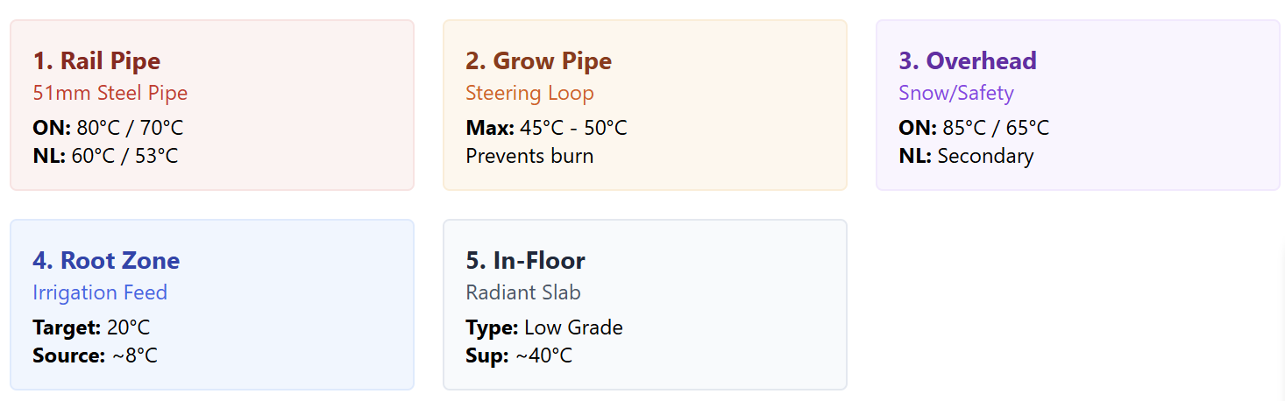
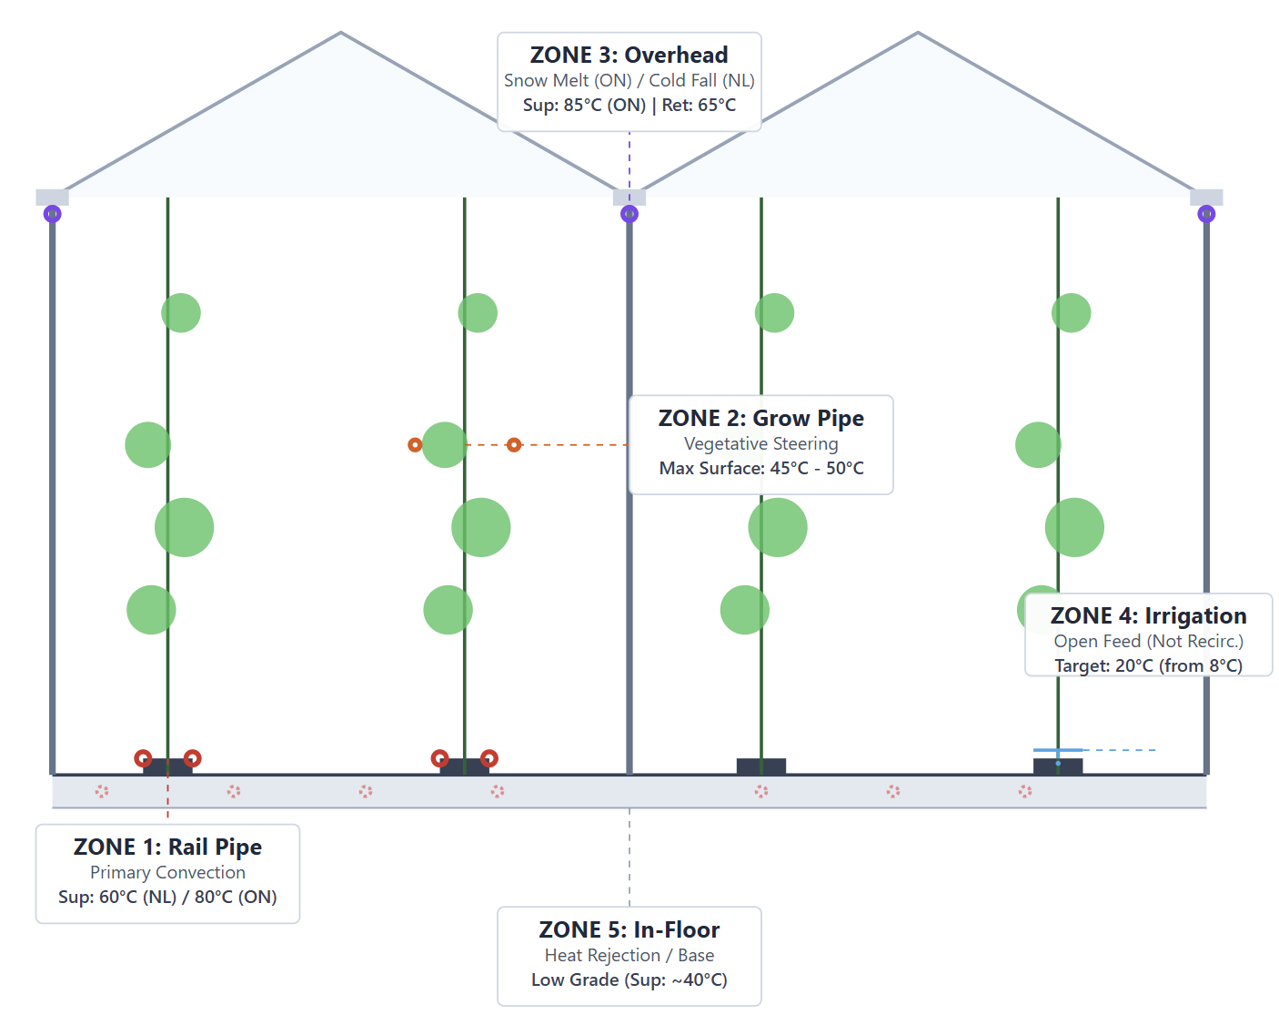
Zonal Heating Locations & Temperatures
Cross-section showing the five thermal zones for greenhouses
Notes:
https://www.pthorticulture.com/en-ca/training-center/heating-systems-temperate-greenhouse#:~:text=Floor%20heating%20is%20another%20method%20to%20heat,pipes%20form%20loops%20covering%20the%20entire%20surface

Slide 7
Greenhouse Heating Demand
Zone | Latitude | Heating Requirement
Lower | 40° to 50° | 250 to 430 kWh/m2/y
Higher | 50° to 60° | 430 to 650 kWh/m2/y
(Source)
Note: Actual heat consumption is significantly affected by crop variety, greenhouse infrastructure, and local climate patterns.

Slide 8
Month | Net Heat Demand (kWh/m2) | Total Energy (MWh) | Zone 5 (Floor) Supply/Return | Zone 1 (Rail) Supply/Return | % Load to Zone 5 | % of Total
Jan | 135 | 5,400 | 45 / 35 | 80 / 65 | 22% | 19.7%
Feb | 115 | 4,600 | 45 / 35 | 75 / 60 | 26% | 16.8%
Mar | 85 | 3,400 | 42 / 32 | 65 / 50 | 35% | 12.4%
Apr | 45 | 1,800 | 40 / 30 | 50 / 40 | 50% | 6.6%
May | 15 | 600 | 35 / 25 | Off | 100% | 2.2%
Jun | 5 | 200 | Off | Off | 0% | 0.7%
Jul | 2 | 80 | Off | Off | 0% | 0.3%
Aug | 3 | 120 | Off | Off | 0% | 0.4%
Sep | 15 | 600 | 35 / 25 | Off | 100% | 2.2%
Oct | 50 | 2,000 | 40 / 30 | 55 / 45 | 50% | 7.3%
Nov | 90 | 3,600 | 42 / 32 | 70 / 55 | 33% | 13.1%
Dec | 125 | 5,000 | 45 / 35 | 80 / 65 | 24% | 18.2%
Total | ~685 | 27,400 |  |  | ~30% Avg | 100.0%
Seasonal Heating Needs:
Netherlands

Slide 9
Zone-by-Zone Hydronic Analysis @ 10MW
Leamington Ont. Canada High Load with Floor Heat
Zone | Load (W/m2) | Total Load (MW) | Supply Temp (°C) | Return Temp (°C) | Design ΔT (°C) | Flow Rate (m3/hr) | Pipe Velocity (m/s)
Zone 1: Rail Pipe | 113 | 4.52 | 85 | 70 | 15 | 260 | 0.8 - 1.2
Zone 2: Grow Pipe | 45 | 1.8 | 50 | 40 | 10 | 155 | 0.5 - 0.8
Zone 3: Overhead | 35 | 1.4 | 85 | 65 | 20 | 60 | 0.4 - 0.6
Zone 4: Irrigation | Negligible* | 0.1 | 40 | 20 | 20 | 4 | N/A
Zone 5: In-Floor | 30 | 1.2 | 45 | 35 | 10 | 103 | 0.5 - 0.8
Peripheral | 15 | 0.6 | 85 | 65 | 20 | 26 | 0.5
Total | 238 | 9.62 |  |  |  | 608
Notes:
https://drygair.com/blog/what-are-the-ideal-conditions-for-greenhouse-tomatoes/

Slide 10
Zone-by-Zone Hydronic Analysis @ 10MW
Target Zone 2, 4, & 5 = 32.2% of Heat Demand
Zone | Load (W/m2) | Total Load (MW) | Supply Temp (°C) | Return Temp (°C) | Design ΔT (°C) | Flow Rate (m3/hr) | Pipe Velocity (m/s)
Zone 1: Rail Pipe | 113 | 4.52 | 85 | 70 | 15 | 260 | 0.8 - 1.2
Zone 2: Grow Pipe | 45 | 1.8 | 50 | 40 | 10 | 155 | 0.5 - 0.8
Zone 3: Overhead | 35 | 1.4 | 85 | 65 | 20 | 60 | 0.4 - 0.6
Zone 4: Irrigation | Negligible* | 0.1 | 40 | 20 | 20 | 4 | N/A
Zone 5: In-Floor | 30 | 1.2 | 45 | 35 | 10 | 103 | 0.5 - 0.8
Peripheral | 15 | 0.6 | 85 | 65 | 20 | 26 | 0.5
Total | 238 | 9.62 |  |  |  | 608
Notes:
https://drygair.com/blog/what-are-the-ideal-conditions-for-greenhouse-tomatoes/

Slide 11
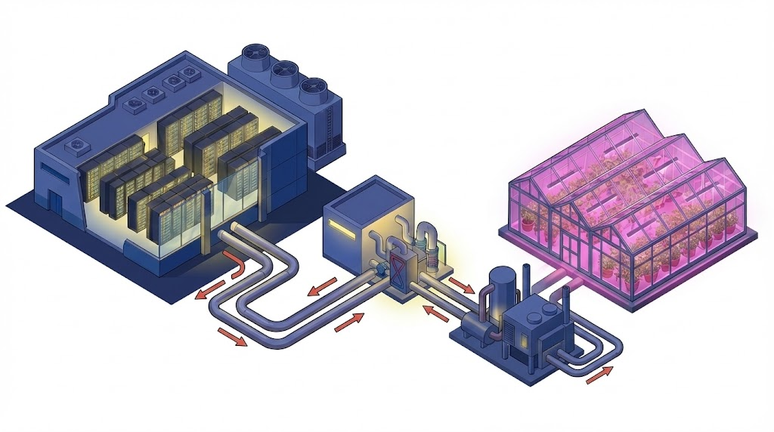
Waste Heat Recovery System
Heat Exchanger
Data Centre
Greenhouse
Waste Heat Output Temperature:
30 deg C / 45 deg C / 60 deg C
Input Hot Water Temperature
28 deg C - 92 deg C
Heat Pump

Slide 12
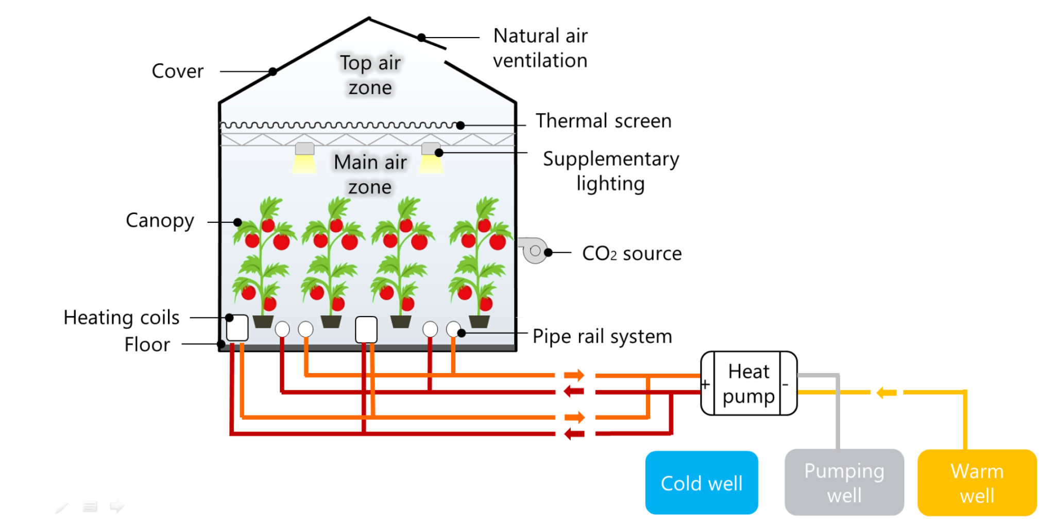
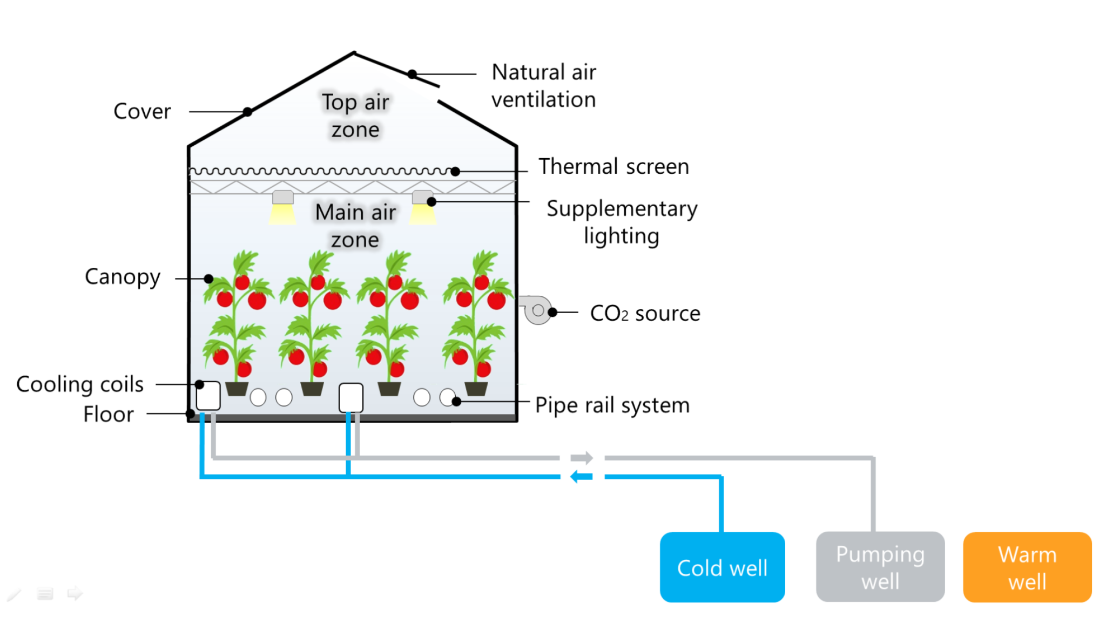
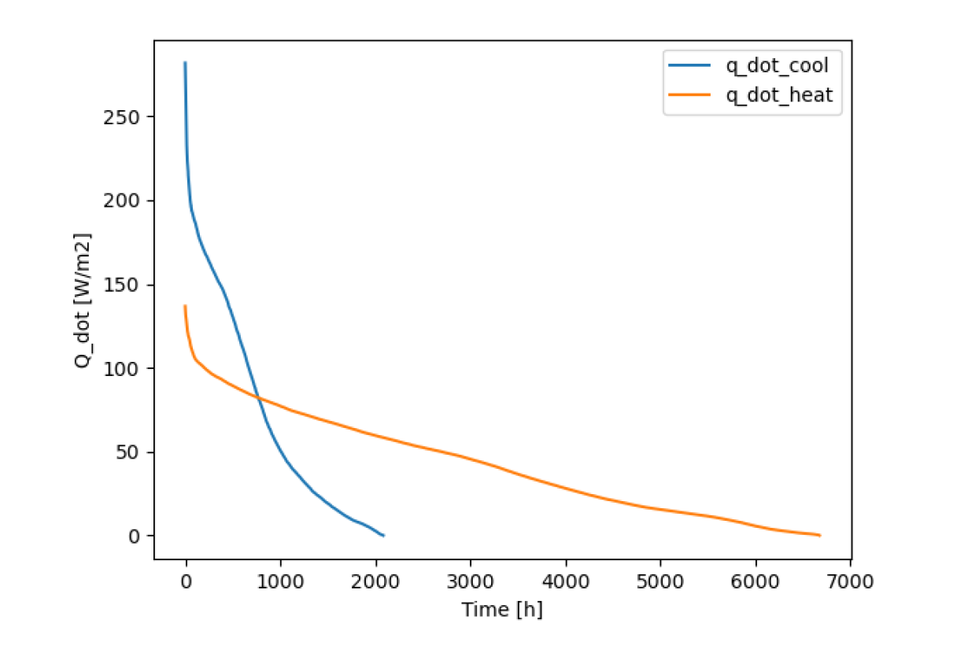
Thermal Storage & Recovery System
Heating Needs
Cooling Needs
Yearly load duration curves of cooling and heating

Slide 13
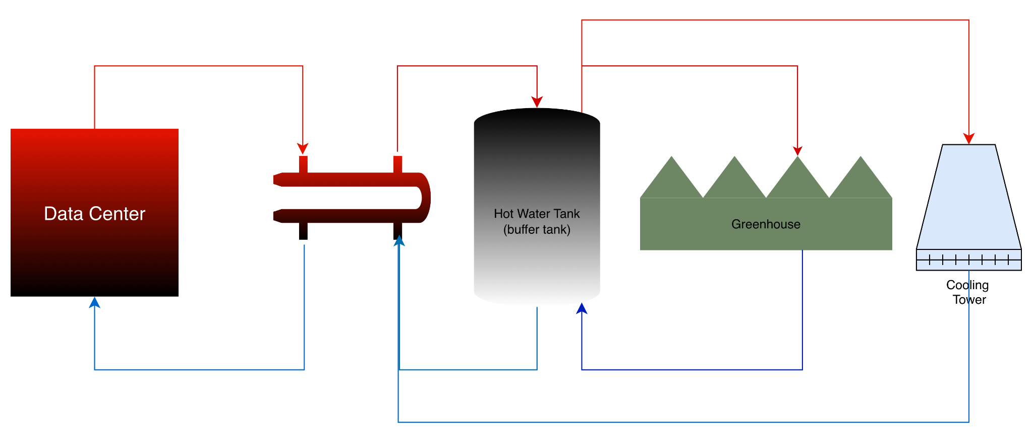
Study 1 - Direct Use With Thermal Storage
Direct utilization of data center waste heat to supply thermal energy for greenhouse vegetable cultivation.

Slide 14
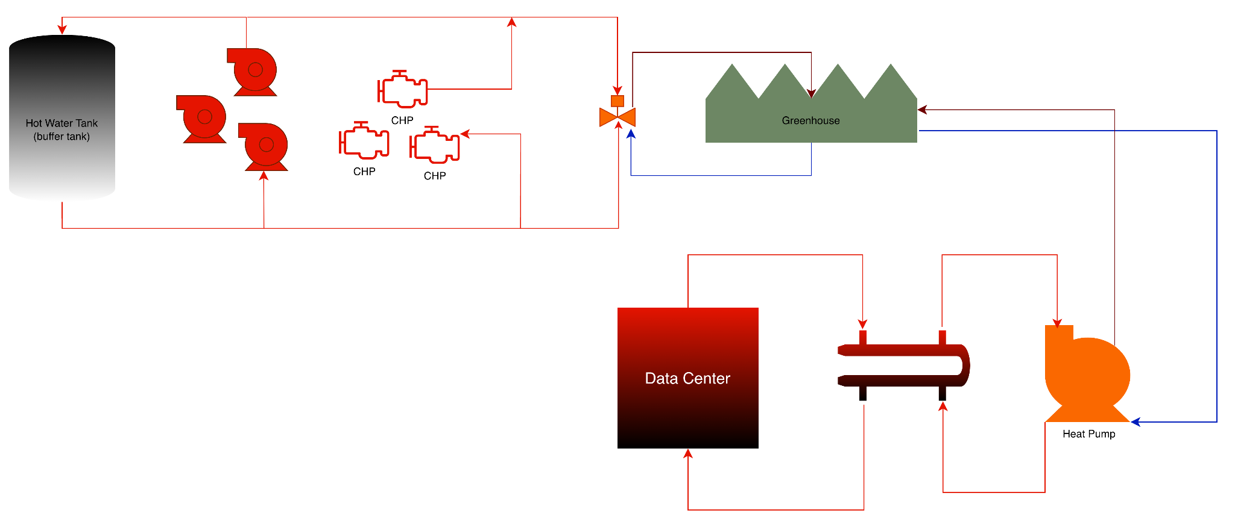
Study 2 - Baseload GH heat Direct: Leamington
Supplying heat to the greenhouse continuous to maintain root zone temperature.

Slide 15
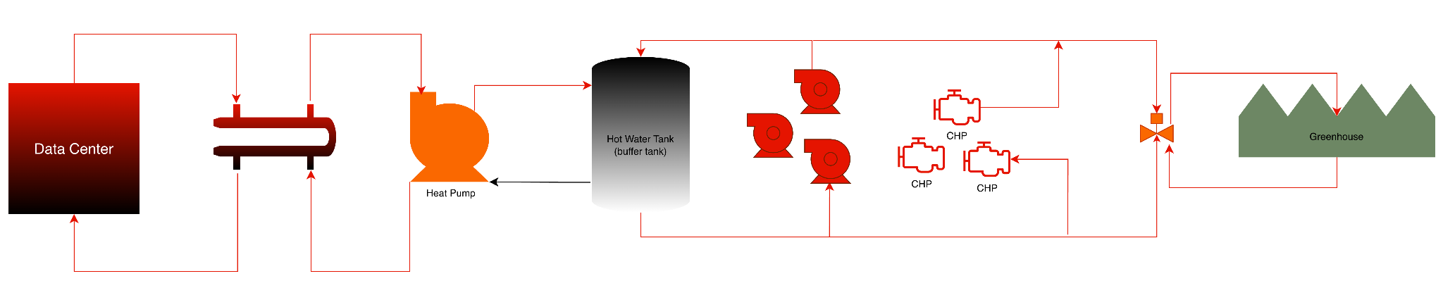
Study 3 - Upgrade and Inject to water tank
Integrating data center heat into the greenhouse’s existing energy loop (hot water storage tank)

Slide 16
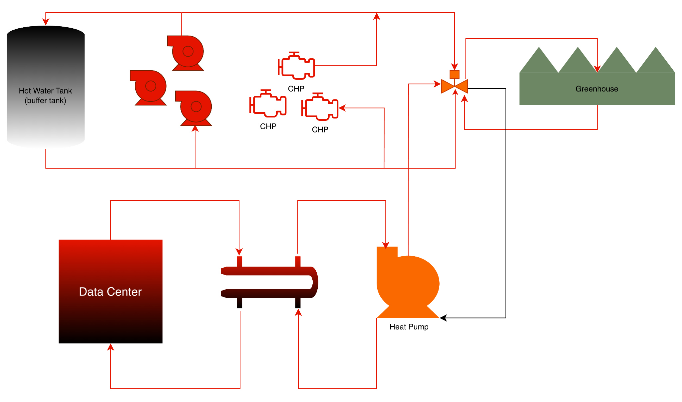
Study 4 - Baseload @ Mixing Valve: Netherlands
Integrating data center heat into the greenhouse’s feed water mixing valve.

Slide 17
Assumptions
 | Data Centre (10 MW) |  | Greenhouse (10 MW)
Study | Output Temperature | Input Temperature | Output Temperature | Input Temperature
1 | 30°C | 18°C | 16°C * | 28°C
 | 45°C | 33°C | 31°C | 43°C
 | 60°C | 48°C | 46°C | 58°C
2 | 30°C | 18°C | 35°C | 45°C
 | 45°C | 33°C | 35°C | 45°C
 | 60°C | 48°C | 40°C | 50°C
3 | 30°C | 18°C | 32°C | 91°C
 | 45°C | 33°C | 32°C | 91°C
 | 60°C | 48°C | 32°C | 91°C
4 | 30°C | 18°C | 35°C | 45°C
 | 45°C | 33°C | 35°C | 45°C
 | 60°C | 48°C | 50°C | 65°C
User of excess heat is: | External use
Type of heat recovery: | HEX (separation) and HP (boost)
Heat source: | Data center cooling (fluid)
Excess heat available capacity: | 10 MW
Excess temp. supply side: | 30˚, 45˚, 60˚C
Excess temp. return side: | 18˚, 33˚, 48˚C
Heat demanded by user: | 10 MW
Supply temp. from HP: | 28, 43, 45, 50, 58, 65, 91 ˚C
Return temp. from consumer: | 31, 32, 35, 40, 46, 50 ˚C
Current type of heating: | Gas Boiler
Cost of current type of heating: | 0.08 €/kWh
Cost of electricity: | 0.08 €/kWh
Agreed heat sales price: | 0.01 €/kWh
A simple numerical method is used, which doesn’t take into account transient behaviour. Pump power calculations are based on affinity laws and typical efficiencies on pumps & motors. Heat pump performance is based on empirical knowledge from applications with medium density refrigerants and using centrifugal compressors and shell & tube evaporators. Where separation heat exchangers are used, we have assumed a 2K approach temperature. CO2 emission factor for gas, oil and electric energy is based on 2021 EIA data. For gas and oil boilers we have assumed a total efficiency of 90% based on hi [kJ/kg without condensation]. Heat-loss in distribution lines are not included in calculation. Service cost estimated as a fixed percentage of CAPEX. CAPEX estimated to be within +/- 20%

Slide 18
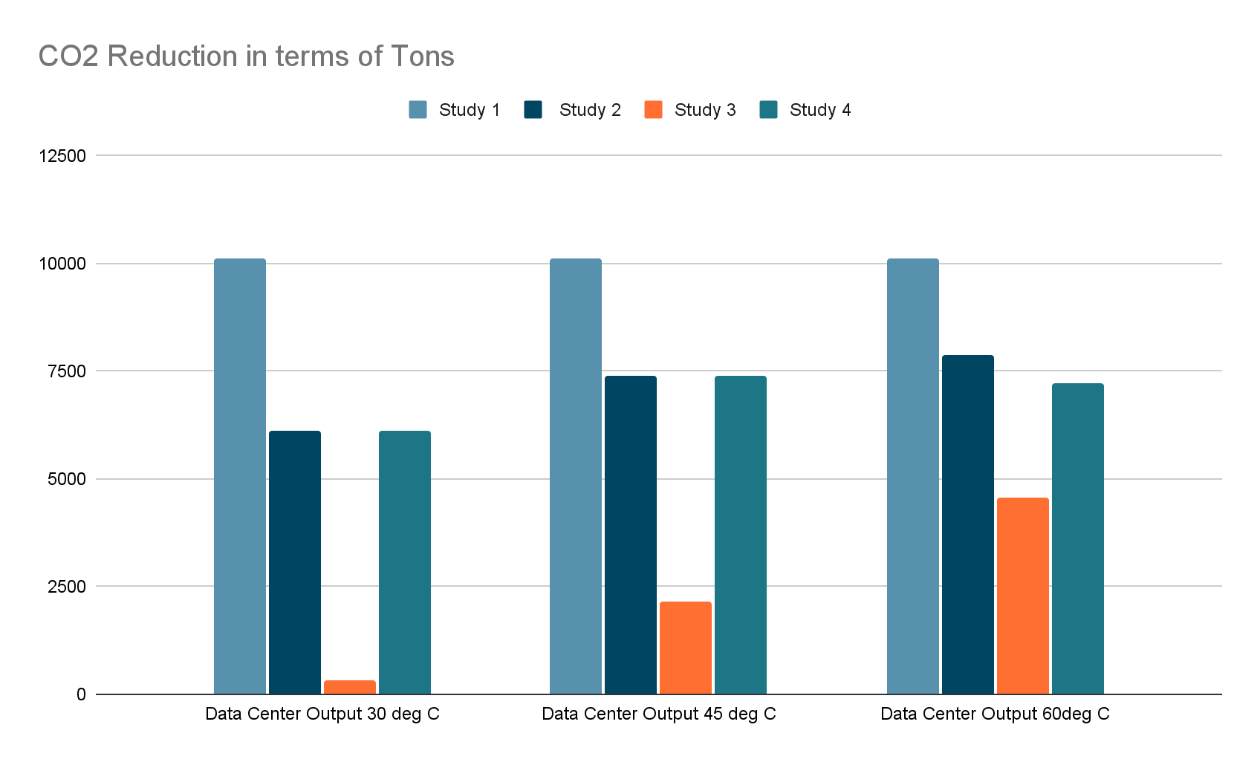
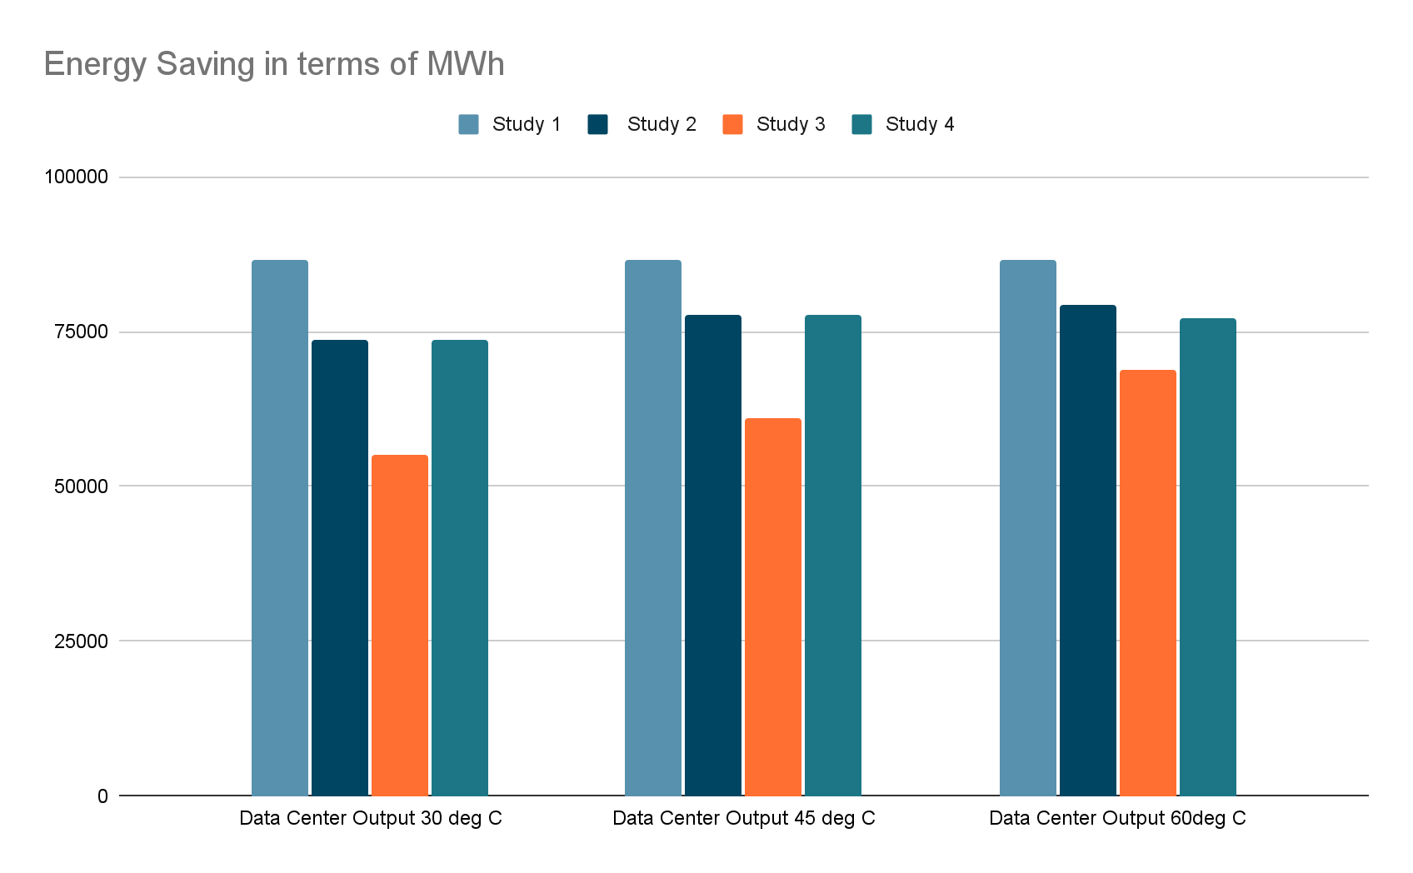
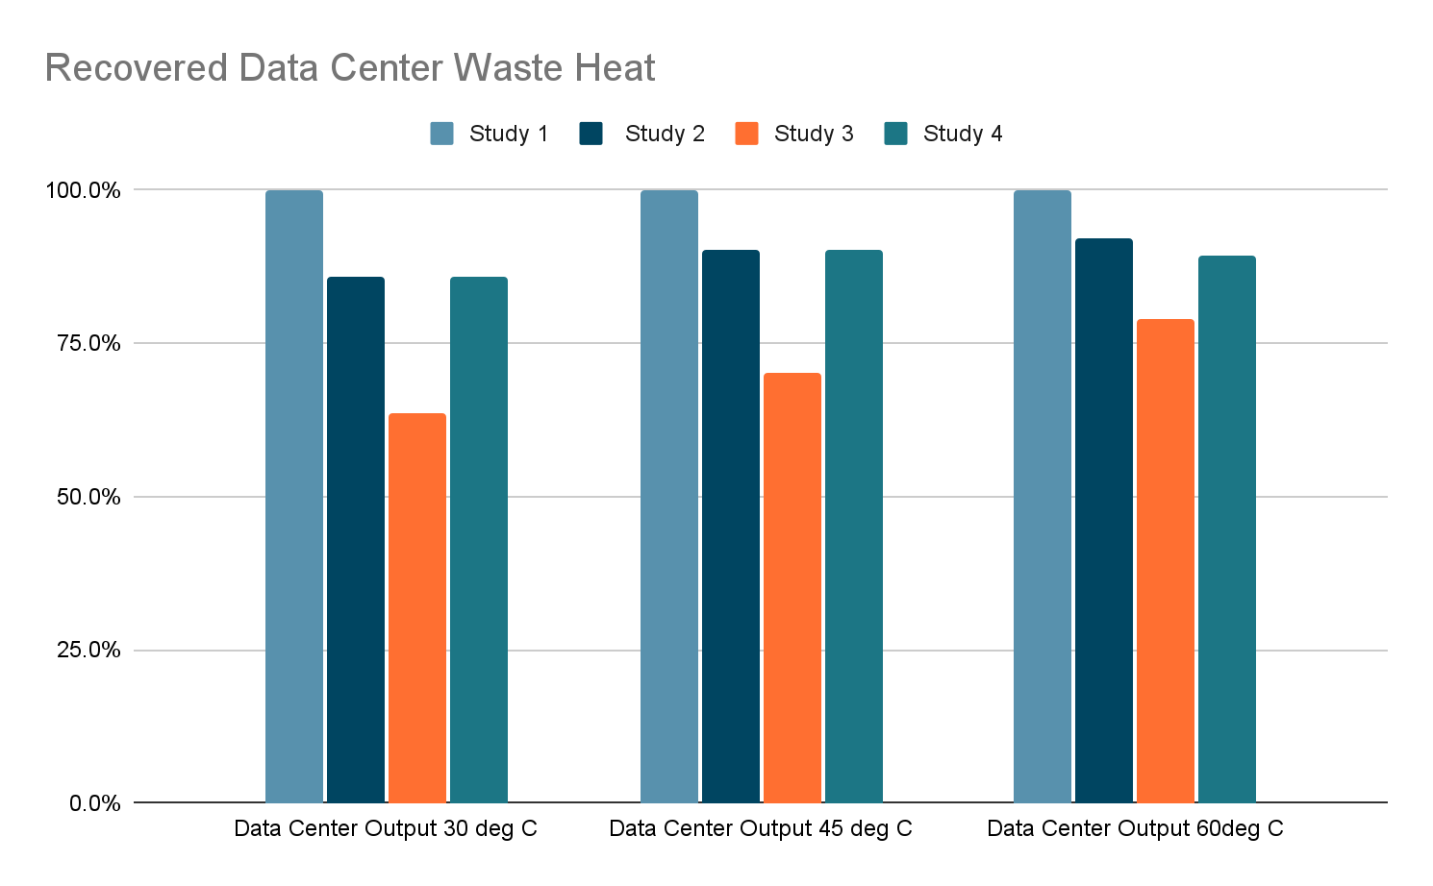
Energy Saving
CO2 Reduction
& Recovered Heat

Slide 19
Economic Analysis
 | Data Centre |  | CAPEX (k€) |  | Annual OPEX (k€) |  | Simple Payback Period (Years)
Study | Output Temperature | Input Temperature | Data Centre (Supplier) | Greenhouse (Consumer) | Data Centre (Supplier) | Greenhouse (Consumer) | Data Centre (Supplier) | Greenhouse (Consumer)
1 | 30°C | 18°C | 3076.72 | 1025.57 | 837.08 | 6968.05 | 3.7 | 0.1
 | 45°C | 33°C | 3076.72 | 1025.57 | 837.08 | 6968.05 | 3.7 | 0.1
 | 60°C | 48°C | 3076.72 | 1025.57 | 837.08 | 6968.05 | 3.7 | 0.1
2 | 30°C | 18°C | 4559.44 | 10017.3 | 714.87 | 4874.31 | 6.4 | 2.1
 | 45°C | 33°C | 4804.11 | 10017.3 | 754.27 | 5518.41 | 6.4 | 1.8
 | 60°C | 48°C | 4900.8 | 10017.3 | 769.83 | 5772.86 | 6.4 | 1.7
3 | 30°C | 18°C | 3376.38 | 10017.3 | 524.4 | 1819.83 | 6.4 | 5.5
 | 45°C | 33°C | 3729.72 | 10017.3 | 581.28 | 2749.86 | 6.4 | 3.6
 | 60°C | 48°C | 4204.52 | 10017.3 | 657.72 | 3999.7 | 6.4 | 2.5
4 | 30°C | 18°C | 4559.44 | 10017.3 | 714.87 | 4874.31 | 6.4 | 2.1
 | 45°C | 33°C | 4804.11 | 10017.3 | 754.27 | 5518.41 | 6.4 | 1.8
 | 60°C | 48°C | 4752.41 | 10017.3 | 745.93 | 5406.21 | 6.4 | 1.9

Slide 20
Heat Recovery Unit
A Heat Exchanger is part of the Data Centre as Supplier.
A Heat Pump is included in the Greenhouse as Consumer.
Summary
10 MW/y
Waste Heat
10 MW/y
Heating Demand
20.4 Hector Greenhouse (Max)
8,658.14 Tons Tomatoes (Avg. Max)
4 Hector Greenhouse (Avg. Size)
Location:
Latitude 50° to 60°

Slide 21
Complexity of Greenhouse Sizing
Greenhouse energy needs are complex. Location plays a major factor in the total annual energy but also peak capacity of the energy needs and the temperatures required to offset the rate of loss during the cold and windy days. Furthermore snowfall and melt requirements add further complexity to maximum temperatures necessary to maintain the structural integrity, crop health and quality.
Optimization of greenhouse size to datacenter rejected waste heat can be approached from a variety of angles.
CO2 Emissions: offsetting natural gas boilers from use providing heat, but also taking into account heat upgrading and temperature needs and load on the heat pump and the local power grid’s CO2 emissions which can change seasonally and by country.
Economics: Cost of heating can be 30% of the operating cost of a greenhouse. These costs can be near eliminated with only minor costs to cool the facility.
Waste Heat Utilization Rate optimized: Minimizing data center rejected heat is another factor to being able consider and could be optimized for.

Slide 22
Complexity of Greenhouse Sizing
Taking the worst case scenario: Study 3.1 - 30°C rejected heat, 18C returning to the datacenter.
A heat pump upgrades this heat to 91°C and puts it into the Thermal storage tank. Heat use is ~6,000-6,500 hrs per year.
Feasible Area Calculation (10 MW Basis):
The 10 MW source capacity defines the maximum grow area.
Middenmeer: 10,000,000 W / 161 W/m2 = ~62,111 sq. m (6.2 Hectares).
Leamington: 10,000,000 W / 238 W/m2 = ~42,016 sq. m (4.2 Hectares).
Design Decision: To facilitate a direct zone-by-zone comparison, we will base the detailed hydronic analysis on a standardized 4.0 Hectare (40,000 m2) facility.
In Leamington, this utilizes ~95% of the 10 MW capacity at peak (Critical constraints).
In Middenmeer, this utilizes ~64% of the 10 MW capacity at peak (High redundancy).

Slide 23
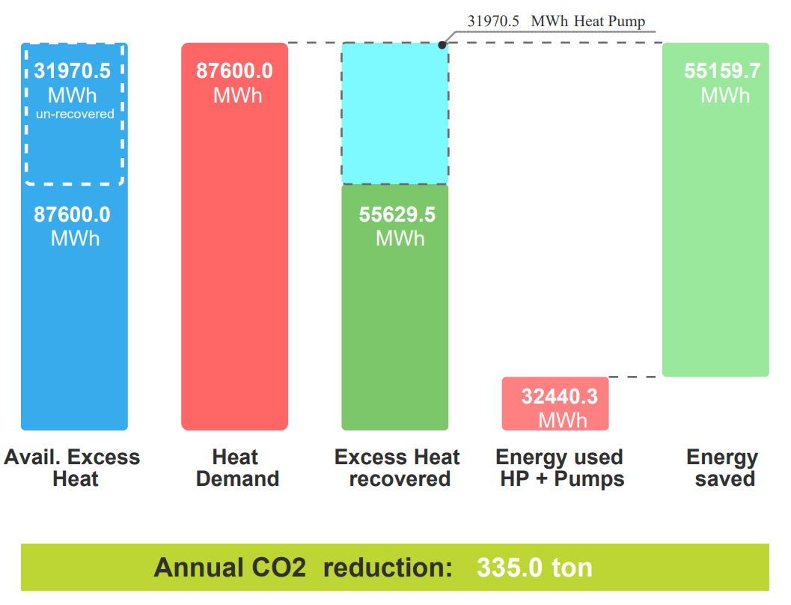
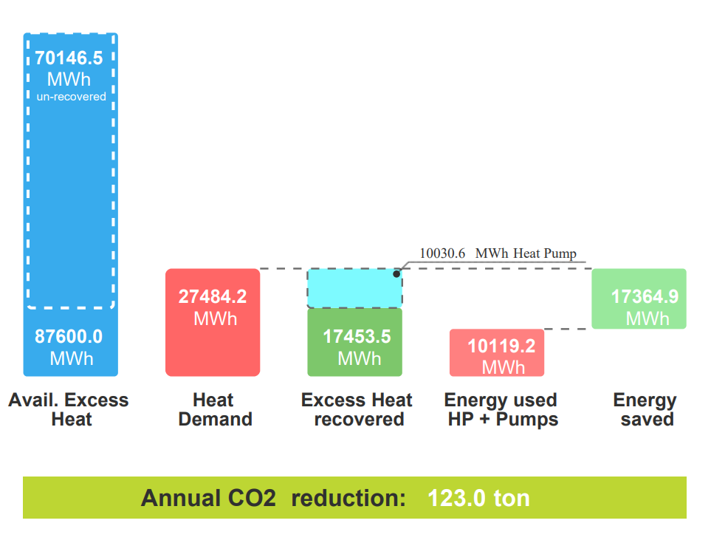
Meet Greenhouse Peak Heating demand ~10MW = 4-6 Hectares
Meet Greenhouse Annual MWh Heating demand @ 10MW DC with Seasonal Storage = ~20 Hectares
40–45°N (e.g., Southern Ontario/Northern US): Greenhouses here typically average around 3,000–3,500 MWh/ha/y.
50–55°N (e.g., Netherlands/Central Germany): Intensive Dutch greenhouses often fall into the 4,500–5,000 MWh/ha/y range to maintain high yields in winter.
60°N+ (e.g., Finland/Northern Canada): Energy needs can exceed 7,000 MWh/ha/y if producing high-light crops like cucumbers throughout the winter.

Slide 24
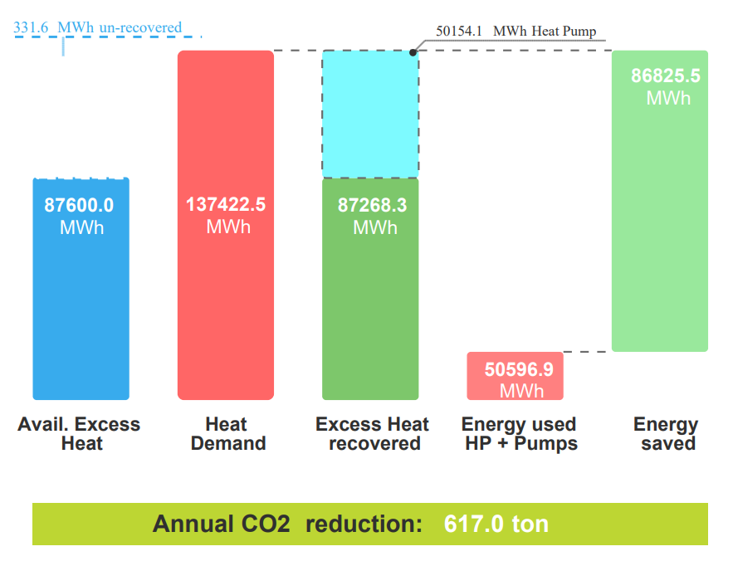
Maximize Data Center Heat reuse
@ 10 MW of rejected heat ~32 Hectares
Ontario Sizing Example
Strategy | Greenhouse Size | % of Waste Heat Utilized | % of Greenhouse Demand Covered | Backup Boiler Needed?
Peak Match (Small) | 4 – 8 ha | ~18% | 100% | No (HP covers peak)
Base Load (Optimal) | 25 – 35 ha | ~60 – 65% | 70 – 80% | Yes (for extreme cold)
Annual Match (Large) | >50 ha | ~70 – 80% | <50% | Massive boiler plant

Slide 25
Greenhouse Sizing Formula: The "DC-to-Food" Formula (for Peak Need)
H (Hectares) = (P_{DC} x N_{rec}) / Peak Heat Demand (MW/ha)
Y (Annual Yield in Tonnes) = H x Y_{crop}
PDC = Data Center IT Load (MW)
N_{rec} = Recovery Efficiency (Typically 0.70 or 70% of IT load is recoverable as usable heat)
Peak Heat Demand = Maximum MW required per hectare based on location
Y_{crop} = Typical annual yield per hectare for your chosen crop (e.g., ~600 tonnes/ha for tomatoes)
Practical Example: 10 MW Data Center in Ontario
If you have a 10MW datacenter in Ontario (45N) and want to grow tomatoes:
1. Recoverable Heat: 10MW x 0.70 = 7MW available. 2. Sizing Greenhouse: 7MW / 2.8MW/ha (avg peak) = 2.5 Hectares. 3. Crop Yield: 2.5ha x 600 tonnes/ha = 1,500 Tonnes of tomatoes per year.

Slide 26
Recommendations
At the end, each site needs to be reviewed and evaluated individually to establish the ideal heat reuse, greenhouse sizing and production facility needs.
It is clear that focusing on utilizing higher temperatures from datacenters rejected heat will have a measurable impact on the reduction of natural gas use from greenhouses. However what has a larger impact is the placement of that heat vs simply injecting that heat into the thermal storage tank from the boilers. Lower temperature thermal storage tanks should be utilized to maximize the rejected heat use. This storage has a much more meaningful impact on the heat utilization rate vs the increase in temperature of the rejected heat.
The sizing of greenhouses to data centers should be maximized to utilize all the rejected heat, but not to replace all the heating needs of a greenhouse. This will ensure commercial viability but ensure that assets are far too oversized for the peak needs, but operate to provide baseload heating needs and support ~80% of the required heat.
Feasible Area Calculation (10 MW Basis):
Sizing Strategy | MWh/yr | Datacenter Heat Utilization | Greenhouse demand (MWh) | Unrecovered Heat (MWh) | Greenhouse Size (ha) | Tomato Production (tons) | Population: Tomato Food Secure (5.5kg/person) | Jobs
Peak Match | 87,600 | 19.9% | 27,484 | 70,146 | 6.4 | 2,716 | 493,902 | 40
Base Load | 87,600 | 63.5% | 87,600 | 31,971 | 20.4 | 8,658 | 1,574,207 | 126
Max Use | 87,600 | 99.6% | 137,423 | 332 | 32 | 13,582 | 2,469,538 | 198

Slide 27
Next Steps
Next research needs should focus around:
Real time, real world data collections from data centre & greenhouse.
Site specific feasibility and sizing.
Thermal storage solutions.
Heat Recovery System risk & reliability analysis.
END SLIDE

